Slide 1
Presentation of Results for Lending Club Investor Returns.
Advanced Business Analytics Capstone Project
By Wendell Moore

Slide 2
About the Client: Lending Club
Lending Club provides the world's largest peer-to-peer lending platform, where borrowers can obtain unsecured personal loans between $1,000 and $40,000, and investors can purchase notes backed by payments made on these loans. Investors can search/browse loan listings on the company’s website (https://www.lendingclub.com) and select loans that they want to invest in based on the information supplied about the borrower. Investors make money from the interest whereas Lending Club makes money by charging borrowers an origination fee and investors a service fee.
It is important to note; investors are exposed to risk and they need to understand the quality of the loans .
Will a loan default?
How much loss will be incurred in a given portfolio?
These are key questions investors should ask when choosing which loan portfolios to invest in so that they can dramatically reduce their risk exposure.
For this project, an investment company is planning to invest $10 million with Lending Club. We have been hired as a consultant to help them choose the loans they want to invest in.

Slide 3
Data Preparation
Loan data was provided by Lending Club, and the following slides lay out our processing steps aimed at helping the investors choose the loans they wish to invest their $10 million. To limit the scope of our project, the file provided contains only data from the year 2015 and has only 36-month loans for credit card debt.
We begin by preparing the data for an exploratory analysis in order to gain a better understanding of it.
Cleanse the data. Remove any irrelevant columns, blank or null data as well as identify and remove outliers.
Process the remaining data, providing the information to the investor to help them with their decision making.
Data Visualization is a vital tool to help communicate results clearly and effectively. See plots from our data on the following slides.

Slide 4
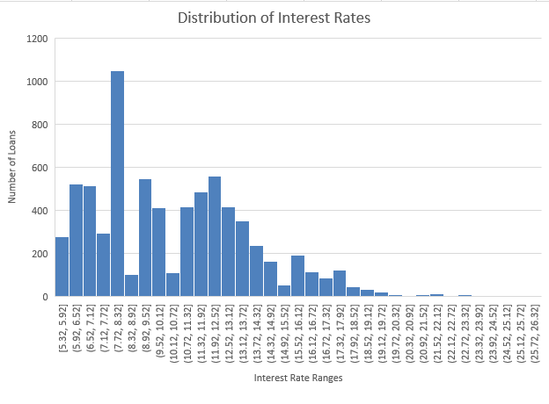
Data Visualization
The graph to the right shows a distribution of interest rate ranges to the number of loans per each range. Notably, it shows that there is a large number of borrowers who have loans with interest rates between 7.72% and 8.32%.
The plot on the following page shows a relationship between the borrower’s annual income and their interest rate. It shows that a large concentration of borrowers have an annual income less than or equal to $200,000, with interest rates greater than 5% and less than or equal to 20%.

Slide 5


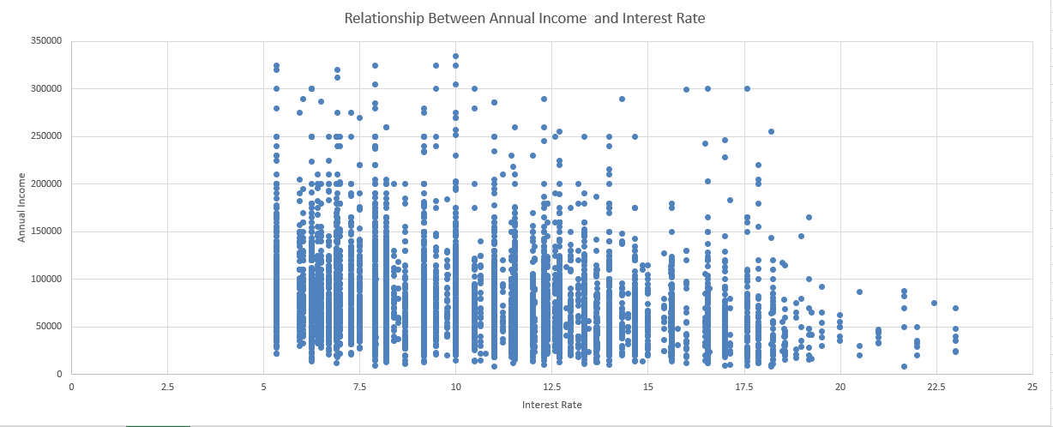




Slide 6
Predictive Analytics Tasks
We used several different Classification Process models to determine if loans were good or bad, because even if a loan is bad, lenders can recover some of the money they lent.
To find good loans we:
Only considered loans that have status equal to Charged Off.
Created a new data column called Loss, which is the difference between Loan Amount and Total Payment.
Split the dataset into training and validation sets using a 60:40 split. This included removing outliers and using several different regression tools with Loss as the dependent variable.
Based on the numbers obtained using these models, we are confident in recommending to the investors that a profit can be made from the loans our prediction models have classified as good.

Slide 7
Prescriptive Analytics Tasks
For the final part of the process we used different Cluster Analysis models to help summarize the data and present an explanation of our results to the investors.
Created 5 homogenous groups (i.e. clusters) of loans and used the statistics associated with these groups to estimate the performance of the loans and find the optimal investment strategy.
Built a Simulation Model, in which we invested $2 million in each cluster to find the expected total return after one year and the chance that the return will exceed half a million dollars.
Next, built an Optimization Model and allocated the $10 million across the five clusters, reporting the expected total return after one year and the chance that the return will exceed $1 million.
See our conclusions to the investor from these models on the next slide.

Slide 8
To The Investor:
Simulation Model
Expected total return after one year should be between $225,000 and $275,000.
Percentage chance that return will exceed $0.5 million is between 0.45% and 0.55%.
Optimization Model
Expected total return after one year should be between $235,000 and $287,000.
Percentage chance that return will exceed $1 million is between 19.6% and 24.0%.

